Slide 1
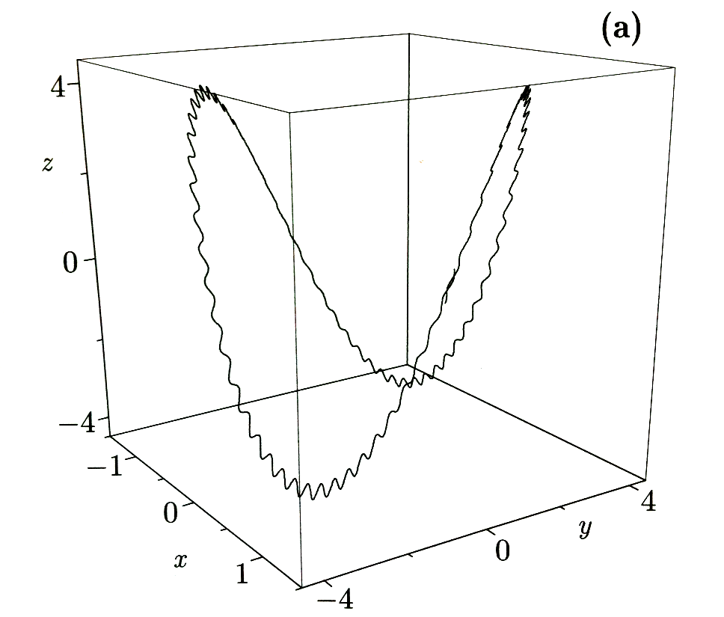
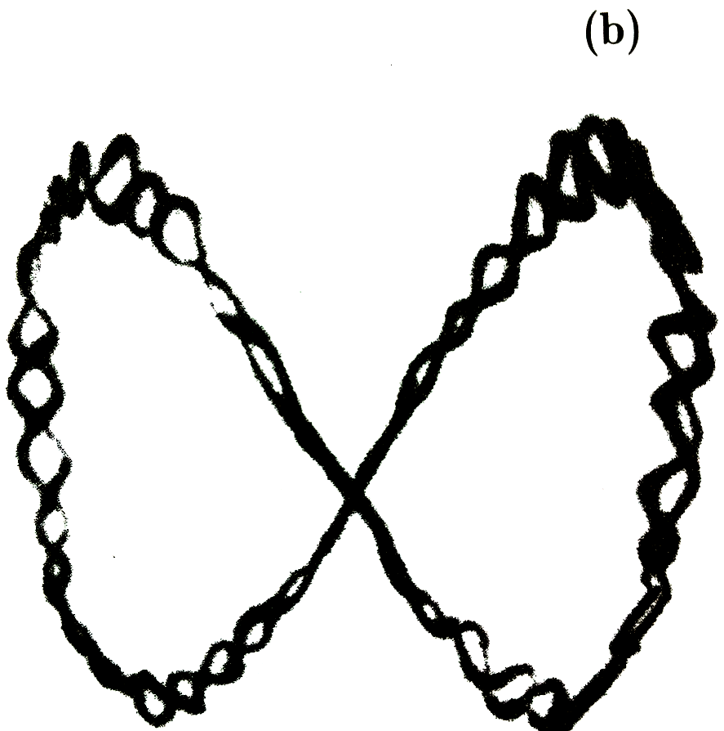
Motion in Paul Trap
Haroche & Raimond, Exploiting the Quantum, Oxford

Slide 2
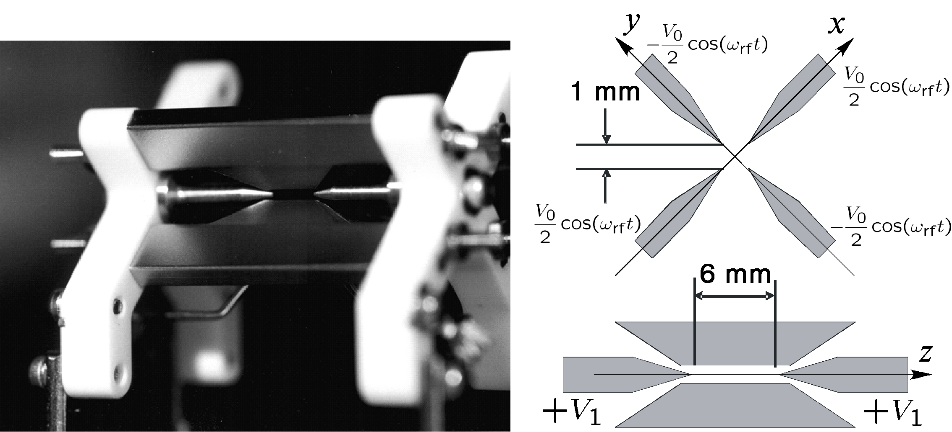
Lineare Paul-Falle
Blatt et al., Innsbruck

Slide 3
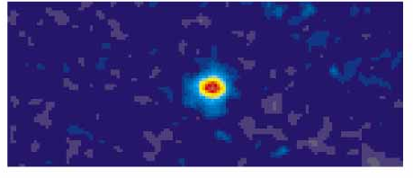
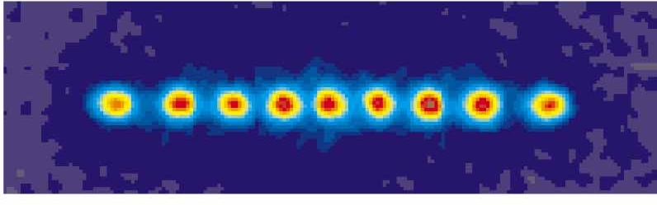
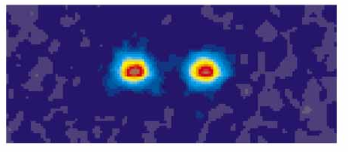
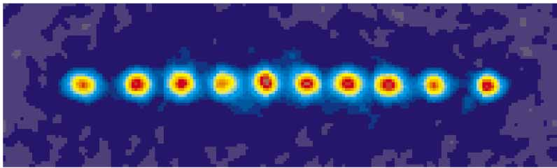
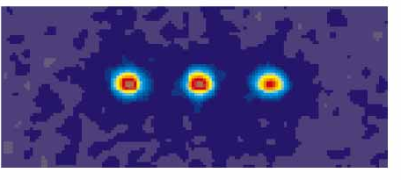
Einige Ionenkristalle
Blatt et al., Innsbruck

Slide 4
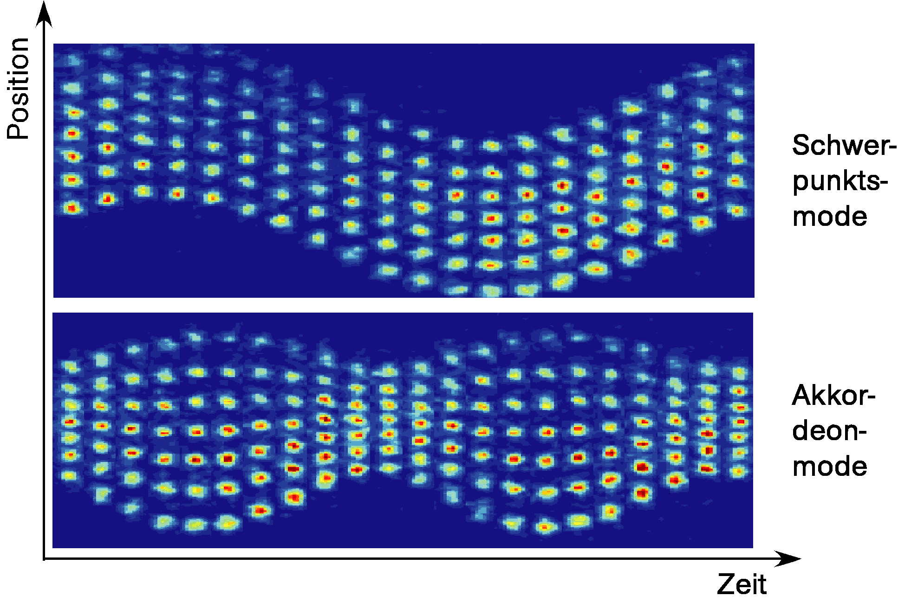
Oszillationsmoden
Blatt et al., Innsbruck

Slide 5
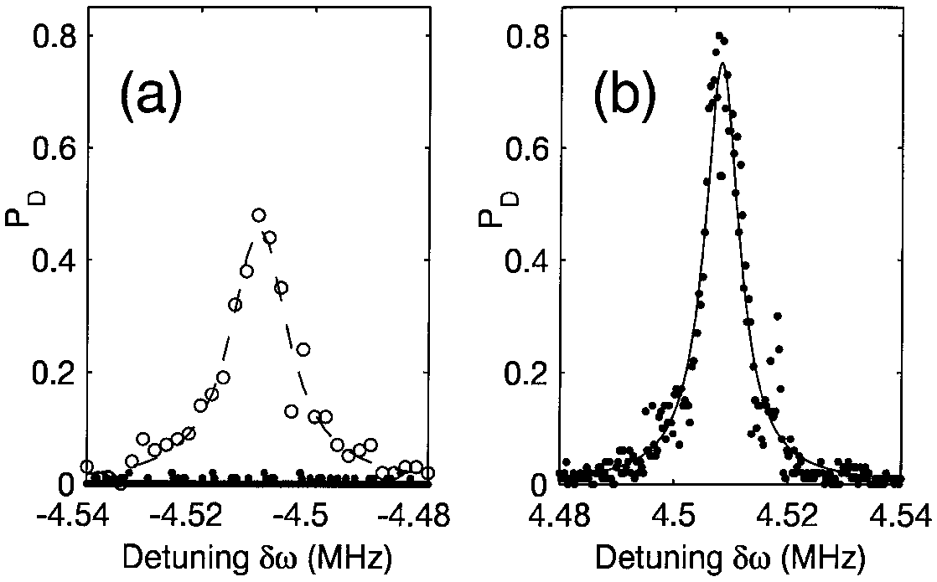
Sideband Absorption Spectrum
before sideband cooling
after sideband cooling
Roos et al., Phys. Rev. Lett. 83, 4713 (1999)

